Slide 1


REGRESSION
ANALYSIS
Presented by: Preet Jain (D023)
Semester IV Project

Slide 2


Overview
01
02
03
04
Introduction
About the Dataset
The Process
Problem Statement &
Variables
05
06
07
08
Inference
Interpretation
Conclusion
Acknowledgement

Slide 3

What is Regression Analysis?
Regression analysis is a simple and statistical method to understand and quantify the relationship between two variables or more.
It's like finding a mathematical formula that best fits the data and allows to make predictions or understand the impact of different factors on an outcome.
Notes:
To be precise, regression analysis helps individuals and businesses determine how changes in one variable are associated with changes in another.
jaise price depend karta hai sales par and etc.

Slide 4


About the Dataset
Name: Company Profit
This dataset contains profit of a company. It includes the expense made on certain things and the profit that it made after that.
Purpose
Source
The primary task is to determine the profit of a company based on a set of features and to make informed decisions.
The original dataset has been obtained from Kaggle and has been slightly modified for the purposes of this project.

Slide 5

COMPONENTS
ID: Unique identifier for each company in the dataset.
R&D: Money spent on research and development activities.
Administration: Expenditure on administrative functions such as office management and support staff.
Marketing Spend: Investment in marketing campaigns and promotional activities.
Longitude: Geographic coordinate (Location) of the company.
Profit: Financial gain achieved by the company after deducting all expenses.

Slide 6
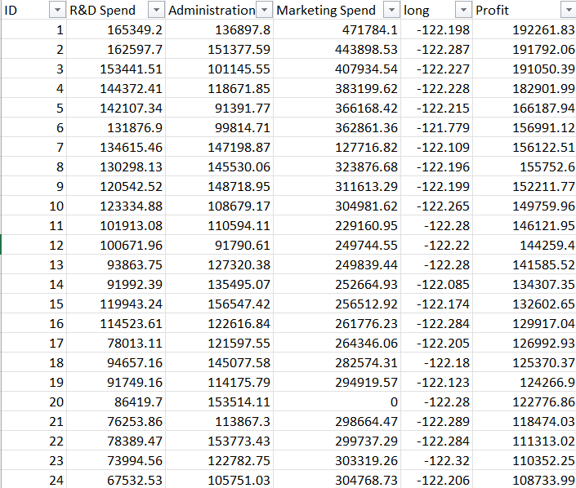

Slide 7

The Process
Step 1: Importing Dataset
Import the dataset. Loading all the Python libraries necessary for carrying out the analysis.
The data analysis is done using Python (specifically, Google Collaboratory).
Python is versatile, with vast libraries, making it efficient for data manipulation, analysis, and visualization.
Step 2: Data Wrangling
Cleaning the data according to the requirements and preparing raw data into a suitable format for future analysis.
Step 3: Data Visualisation
Constructing scatter plot to determine the correlation. Fitting of linear regression model and calculating R squared.

Slide 8

PROBLEM STATEMENT
To determine if administration is negatively or positively correlated with the companies Profit and fit a linear regression model to predict the 'profit using administration along with calculating the R squared.
VARIABLES
X = independent/regressor variable = administration
Y = dependent/response variable = profit
using these variables, we will perform the regression analysis

Slide 9
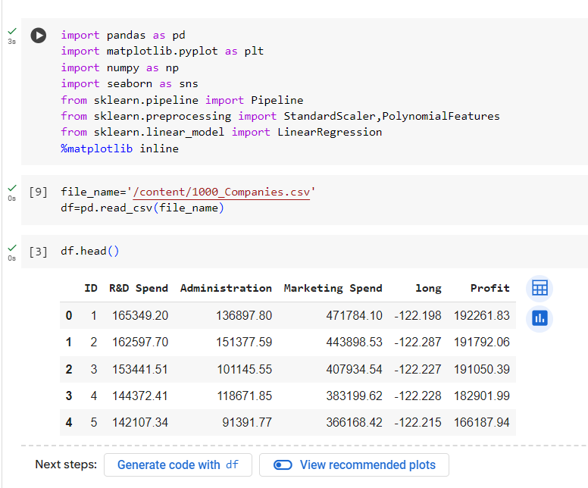
Importing Libraries

Slide 10
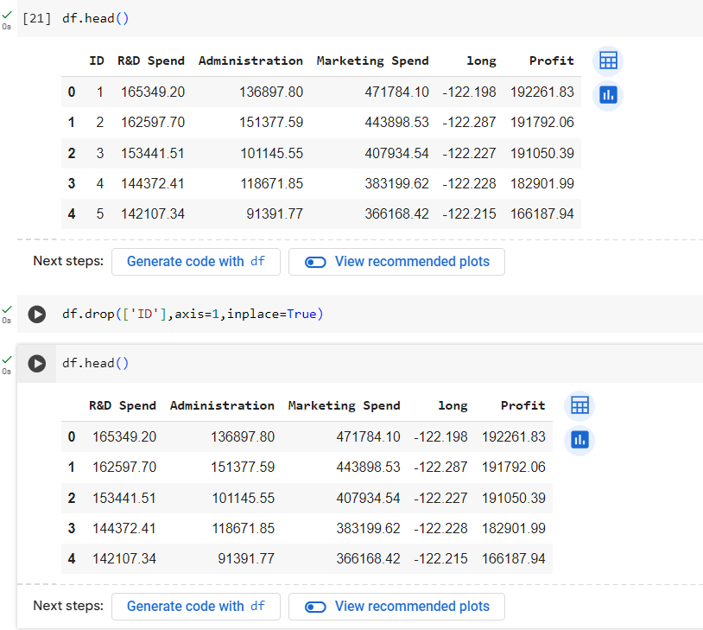
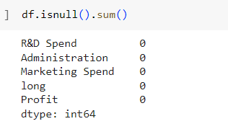
Data Pre-processing

Slide 11
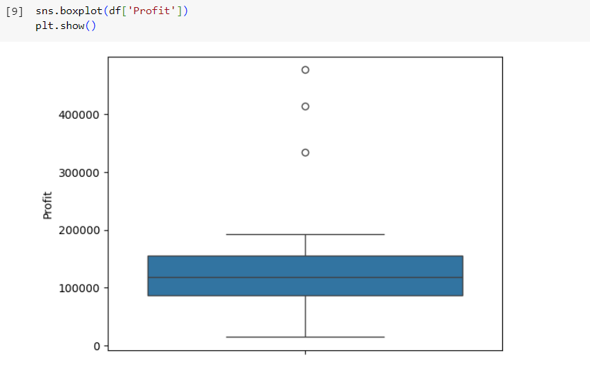
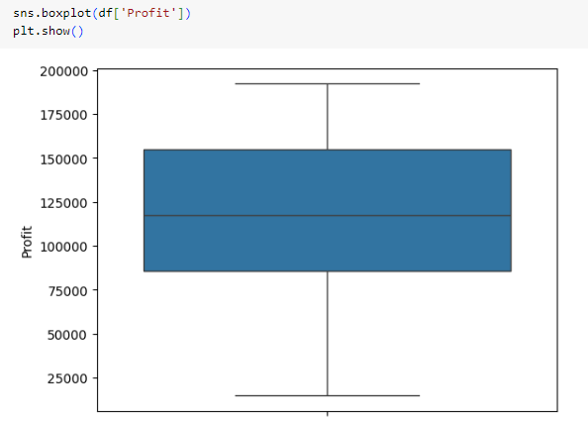

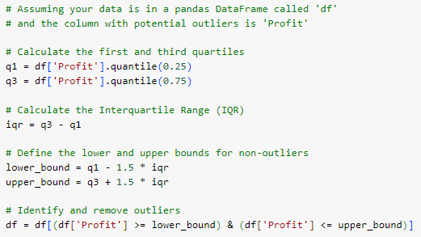
Outliers
Before
After

Slide 12
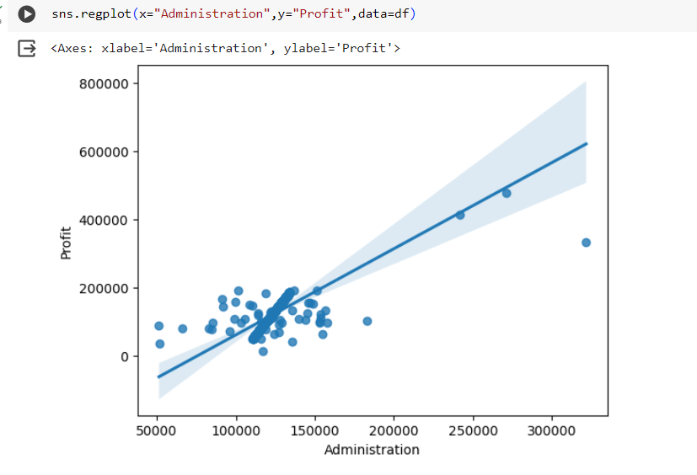

Inference
As evident from the data visualisation, the administration and profit show positive correlation.
This signifies that when administration of a company increases, the profit increases as well.
The function ‘regplot’ in the seaborn library is used to determine if the feature administration is negatively or positively correlated with price.

Slide 13
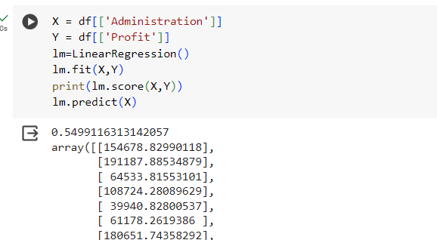

Inference
R-squared (represented by the value lm.score(X, Y)) is a statistical measure that tells us how well the linear regression model fits the data for predicting profit based on administration. Here the output, 0.5499, suggests that the model explains approximately 55% of the variance in companies profit based on the administration.
A simple linear regression model is used to predict the 'Profit’ using the feature 'administration' and calculating the R squared.
Notes:
The array returned by lm.predict(X) represents the predicted prices of houses based on their square footage. Here's a breakdown*
*R-squared* tells you how good your guesses (price predictions) are for the data you used to train the model (square footage and actual prices).
* A value of *0.49* in this case means your guesses are only about *half* on the mark. The model explains roughly half the reason why house prices go up or down based on just square footage. There must be other things affecting price, like location or number of bedrooms, that this model doesn't consider.
* The array you get from the code is like a list of your guesses for each house price based on its square footage.

Slide 14

Interpretation
R-squared is a value between 0 and 1, where:
0 indicates the model explains none of the variance (terrible fit).
1 indicates the model explains all of the variance (perfect fit, which is uncommon in real-world data).
Here, the value of R-squared is approx. 0.5499 which indicates that this linear regression model is not very good. In other words, there are other factors besides administration that influence Profit, and the model doesn't account for those.
Limitation: A high R-squared can be misleading if the model is overly complex or includes irrelevant features.

Slide 15
Conclusion
1
2
3
The model seems to have a moderate fit, as indicated by the R-squared value of 0.5499.
Administration plays a significant role in companie Profit, but there are likely other important factors not considered by this model, such as R&D, marketing spend,etc.
The administration and company profit have positive correlation.

Slide 16
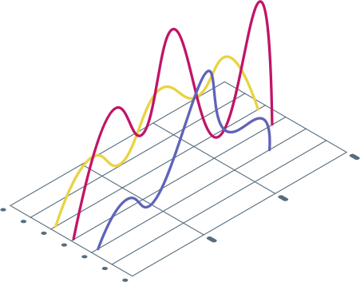
Problem Statement
TO DETERMINE IF THE PROFIT IS NEGATIVELY OR POSITIVELY CORRELATED WITH FEATURE VARIABLES AND FIT A LINEAR REGRESSION MODEL TO PREDICT THE 'PRICE' USING SQUARE FEET ALONG WITH CALCULATING THE R SQUARED.
Variables
X = INDEPENDENT/REGRESSOR VARIABLE = ADMINISTRATION,R&D, MARKETING
Y = dependent/response variable = pROFIT
using these variables, we will perform the regression analysis
FRANCOIS MERCER

Slide 17
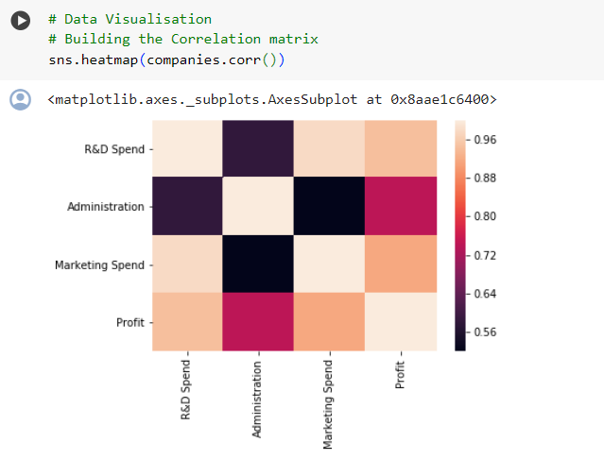
Inference
As evident from the data visualisation, that there is strong correlation between Profit and R&D and weak correlation between Profit and administration
This signifies that when rnd spend of a company increases, the Profit increases as well.
THE FUNCTION ‘HEATMAP’ IN THE SEABORN LIBRARY IS USED TO DETERMINE IF THE FEATURE IS CORRELATED WITH PROFIT.

Slide 18
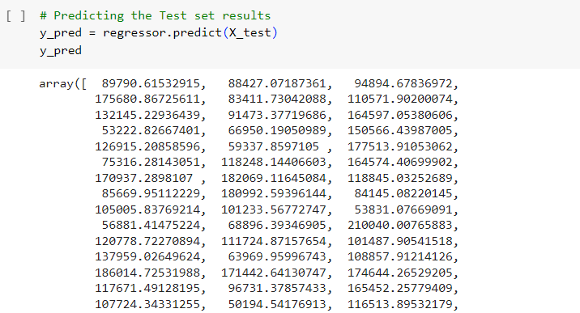
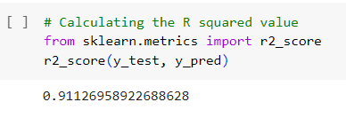
Inference
R-squared (represented by the value r2_score(y_test, y_pred) is a statistical measure that tells us how well the linear regression model fits the data for companies proft based on other features. Here the output, 0.9113, suggests that the model explains approximately 91% of the variance in Companies profit based on the spendings.
A simple linear regression model is used to predict the 'Profit’ using the feature and calculating the R squared.

Slide 19
Interpretation
R-squared is a value between 0 and 1, where:
0 indicates the model explains none of the variance (terrible fit).
1 indicates the model explains all of the variance (perfect fit, which is uncommon in real-world data).
Here, the value of R-squared is approx. 0.9113 which indicates that this linear regression model is good. In other words.
LIMITATION: A HIGH R-SQUARED CAN BE MISLEADING IF THE MODEL IS OVERLY COMPLEX OR INCLUDES IRRELEVANT FEATURES.

Slide 20
Conclusion
2. R&D PLAYS A SIGNIFICANT ROLE IN PROFIT, BUT THERE ARE other important factors THAT WE HAVE INCLUDE IN this model, such as ADMINISTRATION, MARKETING,ETC.
1. THE MODEL SEEMS TO HAVE A BEST FIT, AS INDICATED BY THE R-SQUARED VALUE OF 0.9113.

Slide 21


Thankyou !
presented by
Preet Jain
86032200036
D023

Slide 22


Acknowledgement
I would like to express my sincere gratitude to Dr. Suresh Pathare for his outstanding instruction in regression analysis. His clear explanations and engaging lectures helped me develop a strong foundation in this field. His expertise and insights we﻿re essential for my project's satisfactory results.

